Slide 1
Thoughts on the Harvest
Notes:
Thoughts on the Harvest
Throughout the years of our consecrated life, we have found that the more we learn the more clarity comes to us on this subject of the Harvest. We are not to be saddened if as we walk this narrow way, we find we need to adjust our thinking as the truth continues to unfold to our own hearts and minds. It was true of our dear Pastor who gladly shared with us his understandings as the Lord continued to reveal them and as they became clearer when was revealed the necessity for clarifications on this as well as other subjects.
None of us should assume on any subject that we have no more to learn or possibly need not make any changes or adjustments to our thinking. We all can learn more and as we realize our own undone condition; we may also be awakened that our reasoning may at times have been faulty and, we may not have had all the understanding necessary to reason correctly. Let us then not be dogmatic or claim to know all there is to know respecting this subject or for that matter any other subject. In meekness we should realize that there may still be further revelations respecting its various features that the Lord may be pleased to open and clarify to us as we in time are ready to receive it.
So, it is in this spirit we offer our Thoughts on the Harvest.

Slide 2
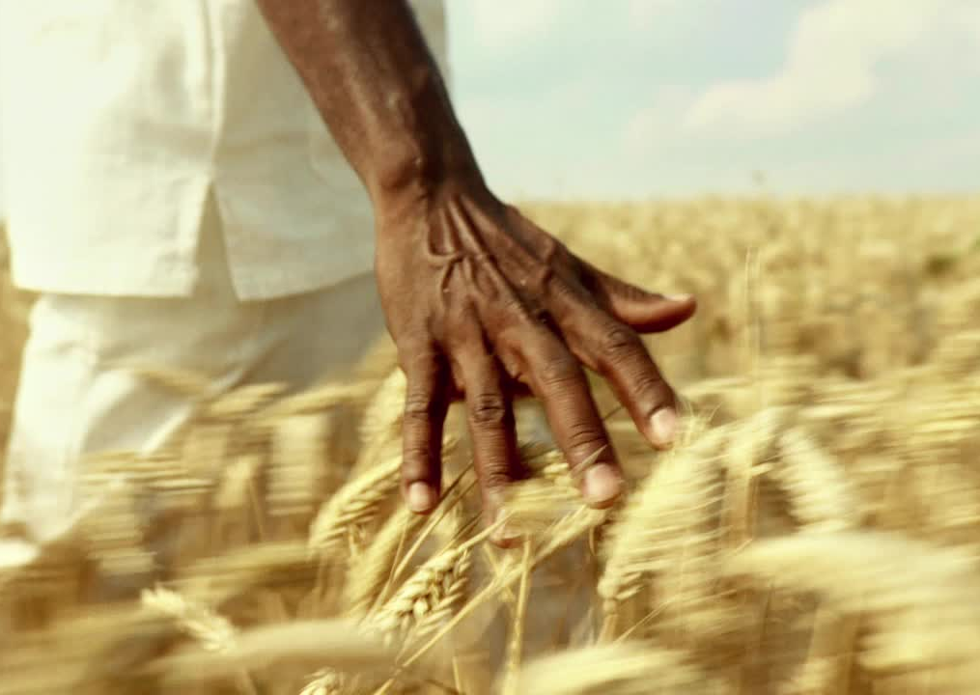
What is the Harvest?
Notes:
What is the Harvest – define work C135?
Br. Russell gives a rather broad definition when describing the Harvest. Page C135. He states, “. It is a time of reaping rather than of sowing, [note: sometimes we stop here and consider that the harvest just pertains to the separating of the wheat, but Br. Russell’s definition goes further] he says it is also “a time of testing, of reckoning, of settlement and of rewarding.”
How important for us to take in the full scope of this definition.
We from time to time throughout our discussion today will look back on the Harvest of the Jewish Age for in observing and comparing its various features it will provide us with a greater understanding of what we may expect concerning the work of the harvest of the Gospel age.
It is the doctrines and teachings of our Lord that sowed the seeds for the growth and eventual harvest of the wheat class. Matt 13:24 Another parable put he forth unto them, saying, The kingdom of heaven is likened unto a man which sowed good seed in his field:

Slide 3
John 4:36 And he that reapeth receiveth wages, and gathereth fruit unto life eternal: that both he that soweth and he that reapeth may rejoice together.
R5824 To those who have the knowledge of God, of His Word, of His Plan, the present and the near future offer certainly the most wonderful opportunities of which we could conceive. Whoever loves the Lord will love the brethren. Whoever would serve the Lord will be intent upon serving the brethren; and the more their need, the better the opportunity; and the greater our zeal, the greater the results for others, and the greater the blessing for ourselves.
B365: bottom “Being already in the "harvest" time, harvest work should engage the time, service and thoughts of the Lord's servants, who now, like the disciples at the first advent, are to do the reaping work. (John 4:35-38) Let us each seek to do what our hands find to do, in obedience to the instructions of the great Chief Reaper. But, with reference more particularly to the time and order of events in this "harvest," …
Notes:
The importance of this study is manifest when we consider the following text:
John 4:36 And he that reapeth receiveth wages, and gathereth fruit unto life eternal: that both he that soweth and he that reapeth may rejoice together.
R5824 To those who have the knowledge of God, of His Word, of His Plan, the present and the near future offer certainly the most wonderful opportunities of which we could conceive. Whoever loves the Lord will love the brethren. Whoever would serve the Lord will be intent upon serving the brethren; and the more their need, the better the opportunity; and the greater our zeal, the greater the results for others, and the greater the blessing for ourselves. John4:36.
Again Br. Russell states, B365: bottom “Being already in the "harvest" time, harvest work should engage the time, service, and thoughts of the Lord's servants, who now, like the disciples at the first advent, are to do the reaping work. (John 4:35-38) Let us each seek to do what our hands find to do, in obedience to the instructions of the great Chief Reaper. But, with reference more particularly to the time and order of events in this "harvest," …
We must therefore, if we are to receive wages, we must understand not only the time of the harvest but also the order of events and work in connection with these which the Lord intends to accomplish during the Harvest, as seen from the definition just given. And this understanding will enable us to participate in that work, and if faithfully executed receive the promised wages, glory, honor, and immortality.

Slide 4
What is the Time of Harvest?
Notes:
What is the Time of Harvest C121, C129 - C132
In general, the timing of the Harvest is identified for us in Matt. 13:39 "The Harvest is the end of the age." And the focus of the time prophecies gives us more specifically the beginning of that period.
As we spoke about yesterday a nexus if you will…
Looking back at 1799 we see…God here begins preparing his consecrated "holy people," his "Sanctuary," for the great blessings he intended for them during the harvest. The blessings of this harvest time being intended also as a special preparation for their entering with Christ into full joy and joint heirs with him, as his bride.
It was at this time, at the end of the 1260 days, that the power of the great oppressor, the man of sin being broken opened the way for bible societies and bible study providing also an awakening to time prophecy and a looking for the return of our Lord when his saints would be gathered to him beyond the veil.
Gently he led them on, step by step, cleansing them first from the papal pollutions ... And as God thus drew them, the Sanctuary class began recognizing the voice of the Good Shepherd exposed the old errors, …," the "Sanctuary," became free, cleansed of defilements, and ready to receive the clean and beautiful principles of truth, on which the Lord and the apostles had founded the Church.
This sanctuary class cleansed from papal defilements were ready to receive “the blessedness” promised at the end of the 1335 days for then they would receive the announcement of the bridegroom presences, the command to come out of her my people and golden vessels of truth returned to them as a result of Babylon’s fall in the time of harvest.
Dan 12:12 Blessed is he that waiteth, and cometh to the thousand three hundred and five and thirty days.
Dan 12:10 Many shall be purified and made white… and none of the wicked shall understand; but the wise shall understand.
The typical Jubilee cycles pointed out A.D. 1874 as the date of our Lord's return; … The wonderful parallelism of the Jewish and Gospel dispensations taught us the same truth with additional features. The same great truth of Messiah’s advent is again told to us in.
Dan 12:1 And at that time shall Michael stand up, [for both spiritual and natural Israel] … there shall be a time of trouble, … at that time thy people shall be delivered.
Having therefore considered the beginning of the Harvest (1874) we may ask do the scriptures mark its end?
This is a tougher question as evidently the scriptures do not give us an exact date as to the ending of the Harvest. Br. Russell originally and for many years thought the parallel dispensations pointed to the end of the harvest. But as he stated in both the forwards of volume 2 and R5950 , that this conclusion was unfounded as the scriptures do not directly give us a date. This uncertainty is then permitted to be a test respecting time and to ensure we do not consecrate to a date but hat our covenant is to be faithful unto death. Rev. 2:10
Some brethren believe that a scripture will be found or that the date is hidden somewhere in the Bible. It should not, however, matter to us. There are scriptures, however, that do tell us how one might realize after the fact that the church is complete.

Slide 5
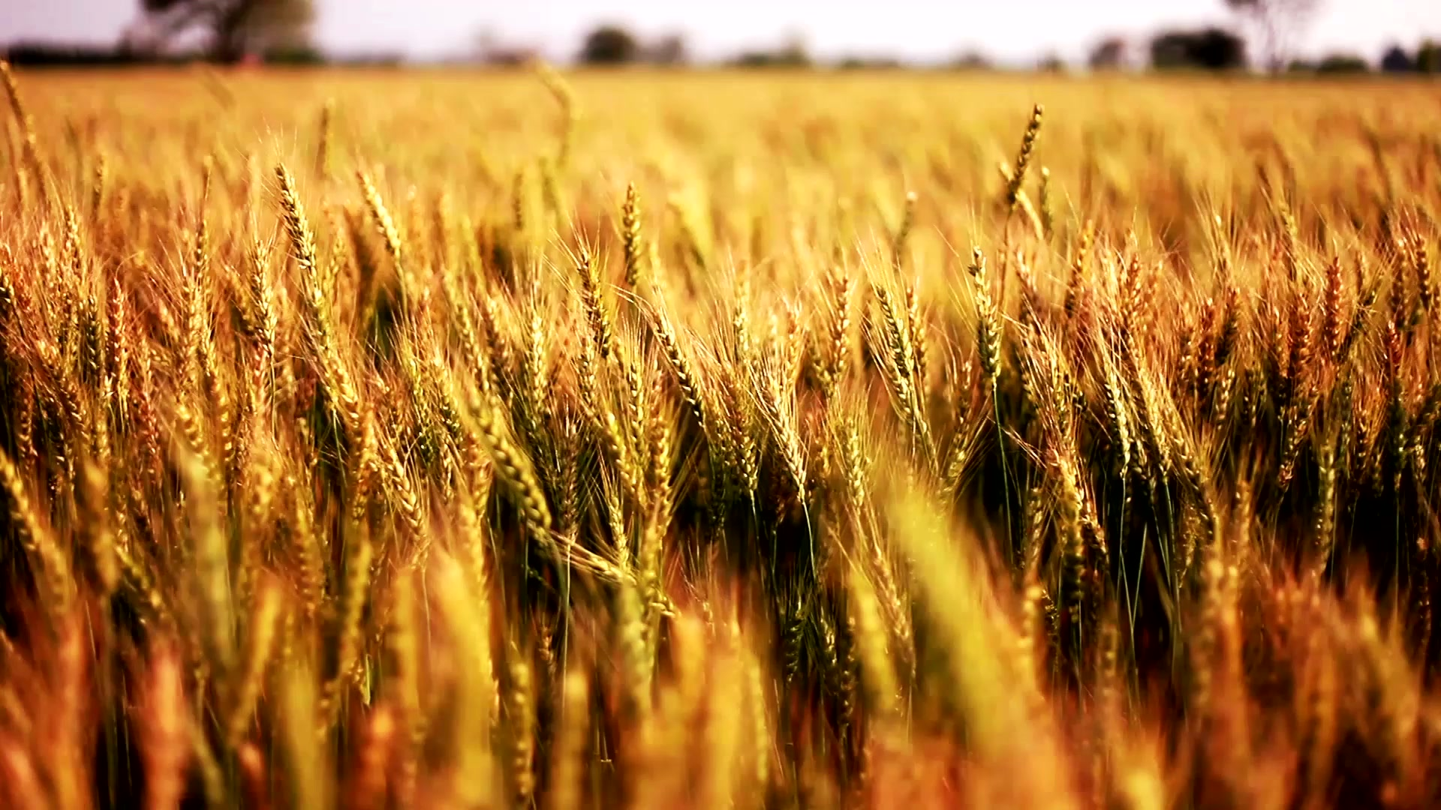
Matt 13:41-43
41 The Son of man shall send forth his angels, and they shall gather out of his kingdom all things that offend, and them which do iniquity;
42 And shall cast them into a furnace of fire: there shall be wailing and gnashing of teeth.
43 Then shall the righteous shine forth as the sun in the kingdom of their Father. Who hath ears to hear, let him hear.
Notes:
Let us consider Matt 13:41-43
41 The Son of man shall send forth his angels, and they shall gather out of his kingdom all things that offend, and them which do iniquity;42 And shall cast them into a furnace of fire: there shall be wailing and gnashing of teeth.
43 Then shall the righteous shine forth as the sun in the kingdom of their Father. …
Concerning this text and vs. forty-three specifically Br. Russell on page C149 says “[What better testimony than this could we have, that the true Church is not yet set up in power, as God’s Kingdom, and that it will not be thus exalted until this harvest is ended?] Then shall this sun of righteousness (of which Christ Jesus will always be the central glory) arise with healing in his beams, to bless, restore, purify, and disinfect from sin and error the whole world of mankind; the incorrigible being destroyed in the second death.” See Mal. 4:2.
Br. Russell consistently held to this that the Harvest could not end until the last, very last, member of the church had completed their course and has been received into glory.

Slide 6
R5950 we read “We imagined that the Harvest work of gathering the Church would be accomplished before the end of the Gentile Times; but nothing in the Bible so said.”
…
…”Our thought was purely an inference, and now we see that it was an unjustified one. This Harvest work belongs to the New Dispensation and cannot be identified with the Old. Anyway the harvesting of the Jewish Age, gathering "Israelites indeed" into the Gospel Church, did not close with A.D. 70, but progressed in various parts of the world thereafter. Quite a good many Jews, doubtless, profiting by their terrible experience, were all the better prepared to be gathered into the Gospel Garner after the destruction of their national polity. Similarly, we may expect that quite good many will yet be gathered to the Heavenly Garner, and we know of no time-limit here.
Notes:
Quoting from R5950
we read “We imagined that the Harvest work of gathering the Church would be accomplished before the end of the Gentile Times; but nothing in the Bible so said.”
What did he say? he said, “We imagined” Br. Russell imagined something that sounded reasonable at the time but was not based upon any clear statement in the scriptures. Is it possible dear brethren that we too could make similar mistakes? Indeed, many of us have.
Br. Russell continues…” Our thought was purely an inference, and now we see that it was an unjustified one. This Harvest work belongs to the New Dispensation and cannot be identified with the Old. Anyway, the harvesting of the Jewish Age, gathering "Israelites indeed" into the Gospel Church, did not close with A.D. 70, but progressed in various parts of the world thereafter. Quite a good many Jews, doubtless, profiting by their terrible experience, were all the better prepared to be gathered into the Gospel Garner after the destruction of their national polity. Similarly, we may expect that quite good many will yet be gathered to the Heavenly Garner, and we know of no time-limit here.”
[If the Pastor knew of know time limit, I doubt that I would be able to come up with one, or for that matter anyone else. No, we walk on by faith just as Elijah continued his journey beyond Jordan to no definite destination.]

Slide 7
Volume 2 forward - Last paragraph
“Our mistake was evidently not in respect to the ending of the Times of the Gentiles; we drew a false conclusion, however, not authorized by the Word of the Lord.”
Notes:
Also, in Volume 2 forward - Last paragraph
“Our mistake was evidently not in respect to the ending of the Times of the Gentiles; we drew a false conclusion, however, not authorized by the Word of the Lord.”
Yes, not authorized. He goes on to explain that the parallels follow the nominal systems to destruction, and then adds “This explanation will help the reader as he studies "THE TIME IS AT HAND.”
Now we know when the harvest began and that it will only end when the Last of the church is complete. Let us consider the interregnum.

Slide 8
Fields white and ready to harvest
John 4:35
Notes:
Fields white and ready to harvest John 4:35
The work of John the Baptist
Jewish Harvest – Combination chaff and few grains of wheat
The work of Moody. Sankey, Whittle and Bliss R4303; QB145,146
Gospel Harvest Combination of tares and few true wheat
Nothing we have said thus far eliminates the type and anti-type relationship between the Jewish and Gospel Age.
As we compare the Jewish Harvest with the Gospel age harvest, we see another form of preparation due to occur making ready the Lord’s people to receive the harvest messages due at each end of the age.
First and in the end of the Jewish age we see the work of John the Baptist, six months before the advent of our Lord at Jordan preparing the hearts and minds of those Israelites indeed baptizing them for the remission of sins and opportunity for all who desired to be forgiven of their sins under the law. Many were in expectation of Messiah which soon John would declare as the Lamb of God which taketh away the sins of the world.
A short while or few months later we find Jesus declaring the time of harvest in John 4:35 Say not ye, there are yet four months, and then cometh harvest? behold, I say unto you, Lift up your eyes, and look on the fields; for they are white already to harvest.
At what was Jesus looking? Some think it was time for the barley harvest and it was this that he referred. But no, he was looking at the Jewish nation at a time in which all of whom if their hearts were right would be able to recognize him as the greater than Moses prophesied, the son of God, their King and deliverer and thus would be able to receive him that they may become sons of God.
Just as Nathanael, an Israelite indeed stated “Rabbi, thou art the Son of God; thou art the King of Israel.” John 1:49. We also remember Peter who answered the Lord’s query, “who do you say I am”? Peter answered, “Thou art the Christ, the Son of the living God.”

Slide 9
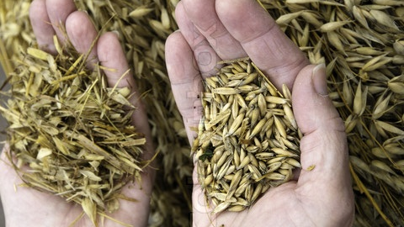
Definition of chaff
The seed coverings and other debris
separated from the seed in threshing grain
Notes:
Wheat and Chaff
Jesus well knew that the majority of the Nation of Israel were not Israelites indeed rather they were what the scriptures term Chaff. i.e., The majority were seed coverings and other associated debris needing to be separated from the true seed in threshing grain.
Remember that Jesus cursed the fig tree and it withered and died. Why? Because it bore no fruit. This is a like picture. For the seed coverings are missing the grain having no fruit or seed inside and thus most of the nation was considered chaff. And as a nation they were cast off and destroyed in the trouble that followed.
Now how does this compare to the Gospel Age harvest.

Slide 10
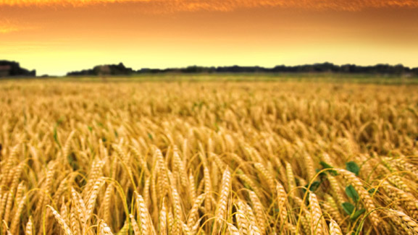
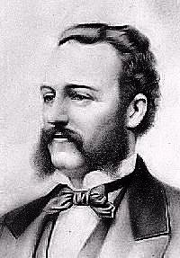
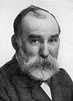
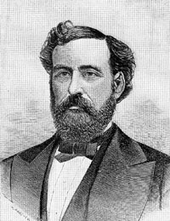
R4303 A considerable work of evangelization took place - Moody and Sankey and, later, Whittle and Bliss revival meetings from 1875 up to 1881.
They made prominent Justification by Faith through the merit of the precious blood of Christ, and urged a full consecration to the Lord, to a degree that has seldom been equaled by evangelists.
It is our thought that the Lord used these men, and through their ministry the fore-ordained number was completed at the fore-ordained time, 1881.
Notes:
Evangelists
A few years prior to our Lord’s return a great Gospel awakening, a revival movement began under the leadership of two prominent individuals Dwight L. Moody, and Daniel W. Whittle
Br: Russell mentions these Evangelist in R4303; QB pages 145,146.
Quoting from R4303 “Looking back to 1881 we find that in the few years preceding that date a considerable work of evangelization took place – Moody and Sankey and, later, Whittle and Bliss revival meetings from 1875 up to 1881. Their work appeared to be of a more substantial kind than that of revivalists generally since. They made prominent Justification by Faith through the merit of the precious blood of Christ, and urged a full consecration to the Lord, to a degree that has seldom been equaled by evangelists. Large numbers professed thorough conversion, under their labors, and the depth of their work and of its hold upon the people is witnessed by a large scale and use of their Gospel hymns. It is our thought that the Lord used these men, and through their ministry the fore-ordained number was completed at the fore-ordained time, 1881.

Slide 11
Question Book page 145 and 146 we quote “…they were talking good, sound sense about consecration, the Lord's Second Coming, etc. I wondered then but could not understand the reason.
By way of interjection, I heard incidentally that while Mr. Moody was near his dying hour, he expressed the thought that he had a great deal of faith in the things written in that book called "Millennial Dawn." I was pleased to hear it and glad that it made his dying hour happy.
Notes:
Evangelists-2
From the Question Book page 145 and 146 we quote “By the way, I remind you of the fact that in 1881, just following the time when Moody, Sankey, Whittle and Bliss had been doing a wonderful work in America and England, stirring up the consecrated people of the world they were talking good, sound sense about consecration, the Lord's Second Coming, etc. I wondered then but could not understand the reason.”
(Br. Russell continues) quote: “By way of interjection I heard incidentally that while Mr. Moody was near his dying hour, he expressed the thought that he had a great deal of faith in the things written in that book called "Millennial Dawn." I was pleased to hear it and glad that it made his dying hour happy.
(continuing) “Now, as I said, in 1881 Messrs. Moody, Sankey, Whittle and Bliss had been stirring up the whole civilized world on the subject of consecration, and apparently a large number made consecration to the Lord.” end of quote.
If these thoughts be correct then we can understand that the full number being called (1881) the statement in John 4:35 would apply here as well, i.e., “Lift up your eyes, and look on the fields; for they are white already to harvest.”

Slide 12
Nominal Jewish and Nominal Christian Systems and the End of all favor
Notes:
Nominal Jewish and Nominal Christian Systems and the End of all favor C216-C223
Now consider another comparison of 36AD to 1881 AS All special favor to Israel even to individuals amongst the nation ended completely and forever in 36AD. The same would be true with the systems of Babylon, which is all exclusive favor ended in 1881 when the full number of the crowns had been apportioned.
Looking then we see that the possibility of the completion of the body of Christ existed with the Jewish nation up until 36 AD and yet they having failed to take advantage of the opportunity it was then necessary to find replacements and this the Lord did in turning to the Gentiles to take out of them a people for His name. Acts 15:14.
John 1:11, 12 He came unto his own, and his own received him not. But as many as received him, to them gave he power to become the sons of God, even to them that believe on his name:
Romans 11:19-20 , The branches were broken off…; because of unbelief they were broken off:
Consequently, there would be a parallel to this in 1881 as a full number of crowns would have been apportioned and after that all exclusive favor would have been removed from that Babylonish system. She would cease being a golden cup in the hand of the Lord Jer. 51:7-9; Babylon was cast off completely and forever no advantage would remain either to Jews staying with Judaism after AD 36 or to believers in Christ remaining being members of Babylon following 1881 the General call having now ended.
So, what happened to all those who had crowns prior to the end or the call in 1881?

Slide 13
F95 To our understanding the general call to this joint heirship with our Redeemer as members of the New Creation of God, ceased in 1881. But we apprehend that a large number (in all the various denominations of Christendom—probably twenty or thirty thousand) who at that time had made full consecration of themselves, have not proven faithful to their covenant of self-sacrifice. These, one by one, as their full measure of testing is reached, if found unfaithful, are rejected from fellowship in the called company—to the intent that others who meantime have consecrated, though not under the call, may be admitted to full relationship in this fellowship with Christ and his joint-heirs, that they, in turn, may stand their testing and, if found unworthy, be similarly rejected and their places be filled by still others who will be waiting in an attitude of consecration.
Notes:
General Call ends 1881
Br. Russell suggested in F95 To our understanding the general call to this joint heirship with our Redeemer as members of the New Creation of God, ceased in 1881. But we apprehend that a large number (in all the various denominations of Christendom—probably twenty or thirty thousand) who at that time had made full consecration of themselves, have not proven faithful to their covenant of self-sacrifice. These, one by one, as their full measure of testing is reached, if found unfaithful, are rejected from fellowship in the called company—to the intent that others who meantime have consecrated, though not under the call, may be admitted to full relationship in this fellowship with Christ and his joint-heirs, that they, in turn, may stand their testing and, if found unworthy, be similarly rejected and their places be filled by still others who will be waiting in an attitude of consecration. [Key phrase - waiting in an attitude of consecration]

Slide 14
Returning to R4303 “Let us suppose that in 1881, when the call closed, there were altogether 40,000 justified and consecrated believers in the precious blood. Some of these had been, perhaps, a long time in the way, and their day of trial was nearly ended. But if our supposition respecting the Moody work be correct, a considerable majority of that 40,000 were in 1881 mere babes in Christ, freshly accepted of the Lord and subject to the message, testings and provings. Seeing the Lord is very patient and long-suffering to usward, it should not surprise us if many of those would have from five to twenty-five years of testing and proving, before their crowns would be declared forfeited.”
Notes:
Crown Estimates
Returning to R4303 (1909) “Let us suppose that in 1881, when the call closed, there were altogether 40,000 justified and consecrated believers in the precious blood. Some of these had been, perhaps, a long time in the way, and their day of trial was nearly ended. But if our supposition respecting the Moody work be correct, a considerable majority of that 40,000 were in 1881 mere babes in Christ, freshly accepted of the Lord and subject to the message, testing and proving. Seeing the Lord is very patient and long-suffering to usward, it should not surprise us if many of those would have from five to twenty-five years of testing and proving, before their crowns would be declared forfeited.”
He goes on to suggest that perhaps 10,000 would prove faithful, leaving 30,000 to be replaced. This then would suggest to our minds that at some point near the end of Br. Russell’s ministry (some 35 years later) or shortly after much of the work being performed would be to find replacements for the original crowns apportioned in 1881.
Should then only 25% of the replacements proved faithful as suggested we can see how it would take a while to find all the necessary saints to complete the little flock.
These considerations caused the Pastor to remark, “I used to think of how small the number is, 144,000, but of late I have been wondering how it will be possible to find the required number.”(QB146)
No wonder then that we find the church not yet complete, nearly 150 years since the Harvest began.

Slide 15
Work of the Harvest
Notes:
Work of the Harvest.
Now let us briefly look at the harvest parables which help describe the work to be done during this harvest period. We will very briefly cover them as I am sure many of you know them very well and time does not permit us to examine each in greater depth.

Slide 16
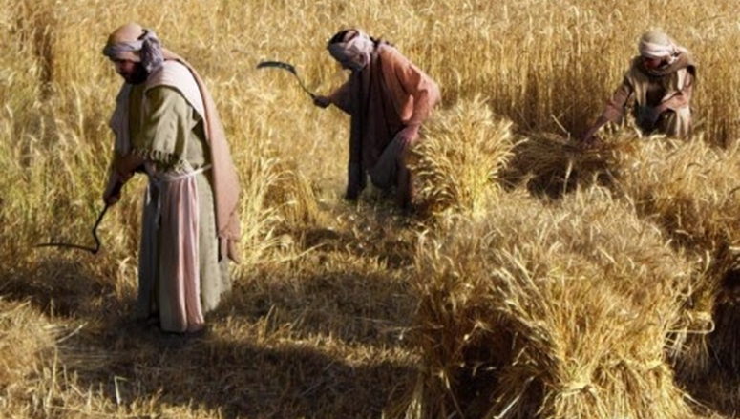
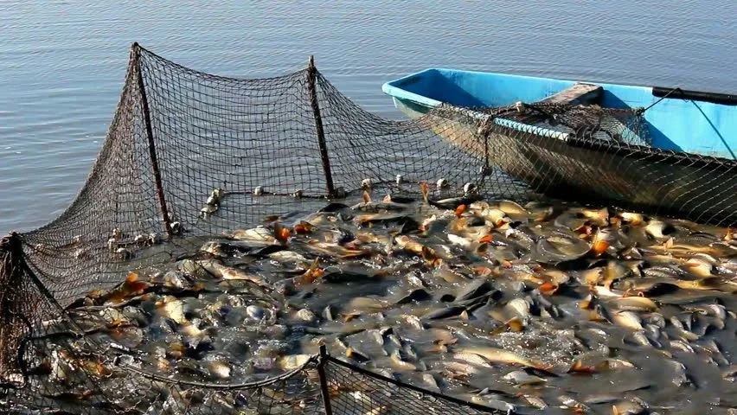
WHEAT AND TARES PARABLE
AND
PARABLE OF THE DRAGNET
Notes:
Separating work
Both the Wheat and Tares Parable; and the Dragnet Parable both Matt. 13; show similar works. They both show a separating work.
In the case of the Wheat and Tares after planting the good seed an evil one came and sowed poor seed (begotten of errors) so that tares then overran the field. It was necessary to allow both to grow together until the harvest. When the harvest time came, they would be more readily distinguished, and the Angels or messengers were then instructed to separate them. The tares would be bundled in readiness to be burned and the wheat would be gathered into the barn.
Wheat represents those who in pure and honest hearts receive the truth the good seed consecrating their all to the Lord. The tare class represents the false Christians the hypocrites who are planted and developed because of the errors which crept into the earlier church leading to the development of the great papal and Babylonish systems predominantly made up of tares.
In the case of the dragnet “This parable represents the nominal Christian Church as the nominal prospective Kingdom of God—the net cast into the sea (the world), which gathered fish (men—Matt. 4:19) of every kind (real Christians, half deceived and deluded Christians, and multitudes of hypocrites); which, when it is full (in the fulness of God’s time), is drawn to shore. “This of course occurs in the Harvest Time.
The casting in of the net represents the invitation to the High Calling and when enough had been called the net was drawn to shore. Immediately a separating of dividing work between the desired type and quantity of fish while casting aside the unworthy ones.
This separation illustrated in these two parables only represented the one part of the work to be accomplished.
On page 188 par. 1 volume3 the Pastor wrote, “Though coming out of Babylon is one step, and a long one, in the direction of complete overcoming, it is by no means the last one; and we should be careful to guard against a disposition to rest after every advance step of the way."
Not only have many fallen away by not heeding the call to come out of her my people but among those who did come out there were many tastings and siftings that took place to determine if they would be faithful unto the end. These testing and siftings continue to our day.

Slide 17
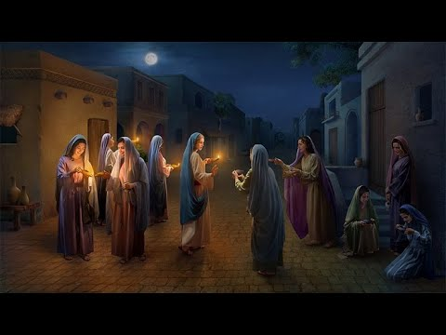
Wise and Foolish Virgins
Notes:
Wise and foolish virgins (1874 and onward)
R5523 “Let us note that all the "virgins" are to hear this Message, "Behold the Bridegroom!" – the expected One has come. It does not follow that they will all hear at once –... . During the period of the "cry," …, all of the virgin class must hear it.”
We would add here that any who come into the truth after 1881 would be required to hear the message “Behold the Bridegroom” our Lord is now present. Here we see that this parable has application even in our day as one enters to replace another who lost their crown, becoming a virgins they would need to understand this and other especially important truths, present truth.
“The "oil" of the parable evidently represents the Holy Spirit, while the "lamps" represent the Bible. All these virgins had the Bible and some light therefrom; but only those possessing the Spirit of the Truth in their hearts in good supply would be able to hold out. To the others the Lamp would cease to burn. They would cease to be able to appreciate and apply the Scriptural prophecies relative to Christ's Second Coming.”
What happens then as respects the foolish virgins? Evidently, they fail to keep their lamps burning brightly by failing to properly study and prove all things and additionally failing to love the truth sufficiently thus allowing their lamps to dim. This class is in danger of allowing their lamps to completely go out.
Matt 6:23 But if thine eye be evil, thy whole body shall be full of darkness. If therefore the light that is in thee be darkness, how great is that darkness!
Eventually the last member of the church will enter the marriage beyond the veil leaving only those foolish virgins remaining this side the veil. These are pictured as knocking wanting entrance into the marriage feast but are refused because they are not recognized as members of the bride class.
This also pictures the closing of the door, which we will have more to say in just a minute but suffice it to say after the wise virgins have entered, no longer will there be any opportunity to be a joint heir with our Lord, a member of the bride class as that opportunity will be closed forever.

Slide 18
Parable of the Wedding Feast
Matt 22:11-14 And when the king came in to see the guests, he saw there a man which had not on a wedding garment: And he saith unto him, Friend, how camest thou in hither not having a wedding garment? And he was speechless. Then said the king to the servants, Bind him hand and foot, and take him away, and cast him into outer darkness; there shall be weeping and gnashing of teeth. For many are called, but few are chosen.
Notes:
Wedding Garment (1878 and onward)
Now let us look at the Wedding Garment test. This is found in Matt 22:1-14. Here we see that three calls went out to gather wedding guests for the Kings son. At the end of this call when sufficient guests had entered the guest chamber an inspection occurs to ensure that all were wearing the wedding robe provided. This inspection is recorded in versus 11-14.
And when the king came in to see the guests, he saw there a man which had not on a wedding garment. The king said to the servants, Bind him hand and foot, and take him away, and cast him into outer darkness; there shall be weeping and gnashing of teeth. For many are called, but few are chosen.
The robe pictures our wedding garment or robe of Christ’s righteousness. And all those who had entered the guest chamber needed to have it on to even gain entrance. The fact that the King found one who was not wearing a robe indicates that he had taken it off, representing those who through pride and vain glory feel their position with the King had to do with their own merit thus counting the blood of Christ a common thing. These who fall away are not of the great company but rather represent those who go into second death.
Hebrews 10:28-29; He that despised Moses' law died without mercy under two or three witnesses: Of how much sorer punishment, suppose ye, shall he be thought worthy, who hath trodden under foot the Son of God, and hath counted the blood of the covenant, wherewith he was sanctified, an unholy thing, and hath done despite unto the Spirit of grace?

Slide 19
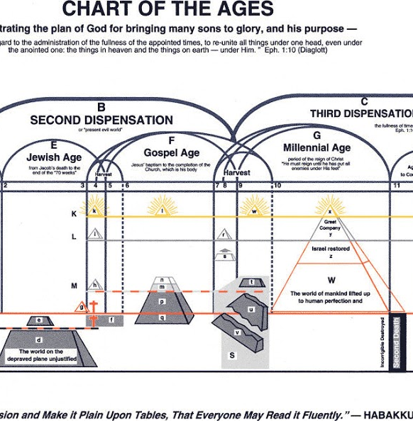
The Sealing Work
Notes:
The Sealing Work C164-C167 top Ezek 9
Information necessary to separate from Babylon
Necessary to be unhurt from the trouble
Scriptures: Rev. 18:4; Rev. 7:3; Dan 12:10;
We read of this in Rev. 7:3 Saying, Hurt not the earth, neither the sea, nor the trees, till we have sealed the servants of our God in their foreheads.
While this work is going on, the time of trouble that would eventually lead to the full destruction of Babylon is restrained held back from its destructive work so that first a sealing in the heads of the 144,000 should take place. This sealing represents an intellectual appreciation of present truth. It is the same truth that does the separating work and includes the call of Rev. 18:4 to come out of Babylon. Failing to come out they will be considered as sympathetic with the errors of doctrine and practice which condemn Great Babylon to destruction. These will be accounted worthy then to share in her destruction.
In Ezekiel 9:1-6 we see an illustration of this sealing work. Here in one of Ezekiel’s visions he sees a Man with the writers’ inkhorn which we believe represents Br. Russell, the seventh messenger to the church. The Glory of God calls to the man and tells him to place a mark on the foreheads of all those who sigh and cry, these being out of sympathy with the abominations found in the city (Jerusalem) picturing the City of Babylon. After this work is completed another six men who had slaughter weapons in their hands went through out the city to destroy with out mercy.
Verse 6 reads “Slay utterly old and young, both maids, and little children, and women: but come not near any man upon whom is the mark; and begin at my sanctuary.” Judgement here begins at the house of God 1Peter 4:17. This shows that the trouble would begin with the collapse of Christendom.

Slide 20
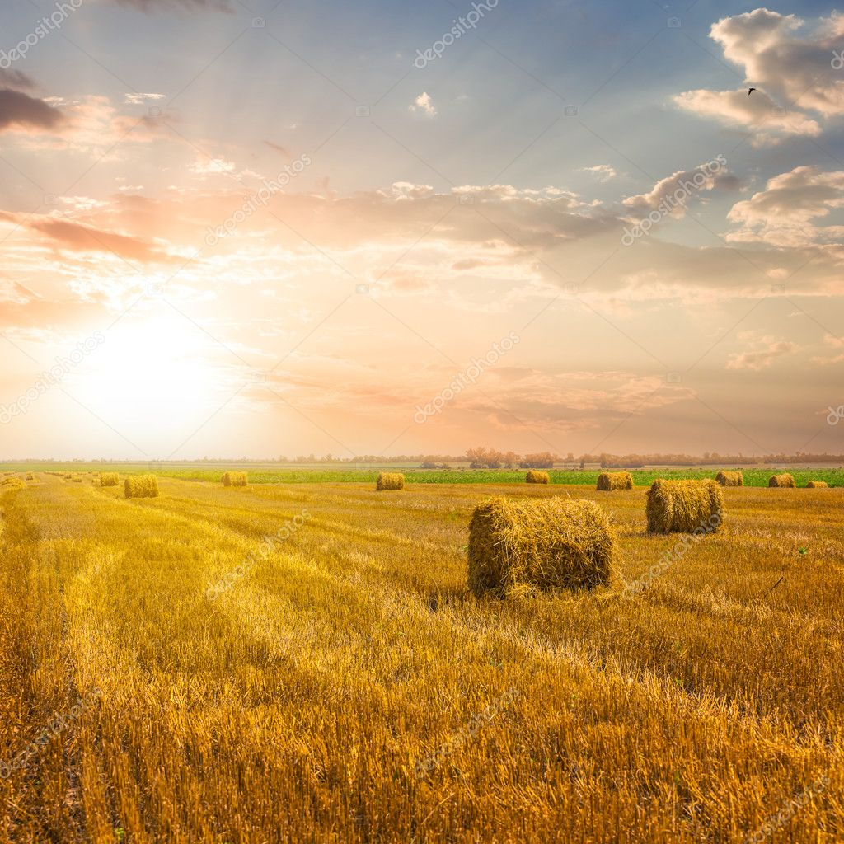
In volume 3 on page 223 says, “The living members of Christ’s Church laboring in his vineyard at any time during this Gospel age represent all the laborers. And the parable shows, as its particular feature, a class who enter this service of the Lord when the day’s work is about done, at the “eleventh [the last] hour.” They are represented as some desirous of engaging in the Master’s service, but too late, the general call having ended. They say—“No man hath hired us,” we were too late to get into the service under the call.
Notes:
Eleventh hour parable
Matt 20:1-14. Still another parable tells us how a householder hires laborers for work in his vineyard. He hires laborers early in the morning again about the third hour, then the sixth and then the ninth hour. Toward the end of the day about the eleventh-hour men were found standing and idle and when asked about it replied, “no one has hired us” the householder replies, “Go ye also into the vineyard;”
We mention this parable to point out that the men standing idle at the eleventh hour being the last hour represents those who were not called prior to 1881.
In volume 3 on page 223 says, “The living members of Christ’s Church laboring in his vineyard at any time during this Gospel age represent all the laborers. And the parable shows, as its particular feature, a class who enter this service of the Lord when the day’s work is about done, at the “eleventh [the last] hour.” They are represented as desirous of engaging in the Master’s service, but too late, the general call having ended. They say—“No man hath hired us,” we were too late to get into the service under the call.
Here we have another picture of the replacements who, although not called before 1881, can still come in and work. Earlier we read where the Pastor referred to these as waiting in a consecrated attitude of heart.

Slide 21
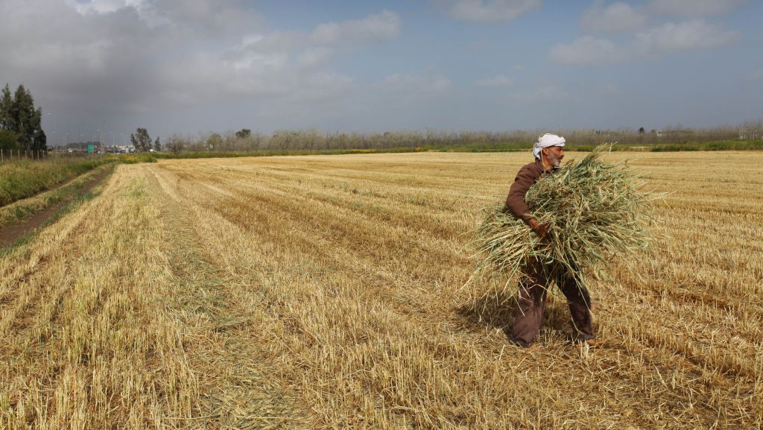
Gleaning…..
Notes:
Gleaning
Pre 1914 Stats on tracks, volumes, other work
Post 1914 Stats on tracks, volumes, other work
Gleaning work?
The corners of the field
Left for Ruth
Africa, Philippines, India, area’s of the world former colonies of the Kingdoms of this world. – replacements being found – few though they be.
The concept of gleaning we do not find in the parables just considered nevertheless Br. Russell uses the term.
Gleaning is the custom of allowing the poor to reap the corners of the field. (Ruth 2:2-23). (Leviticus 19:9; 23:22; Deuteronomy 24:19-21). Is there an application in our study of the harvest? If so, how may it be applied?
Br Russell in R5950 published in September 1916 just before his death had this to say. “SOME of us were quite strongly convinced that the Harvest would be ended by now, but our expectations must not be allowed to weigh anything as against the facts. The fact is that the Harvest Work is going grandly on; it is not ended by any means. …. At first, we were inclined to surmise that the Harvest proper had closed in October 1914, and that the work since going on was a gleaning work; but the facts seem not to bear this out. The progress of the work and the numbers who are being brought to a knowledge of the Truth and separated to the Lord are far too great to be styled a gleaning. Evidently it is a part of the regular Harvest.”
What are we to make from this? Let us look briefly at the history of the bible students since 1916.
The harvest work from 1914 to 1916 was already in decline as evidenced by the Annual Reports in the towers. The amount of funds available had been reduced by nearly half from its peak in 1914. In 1915 many colporteurs were required to leave the work and seek employment as they could no longer meet their expenses.
Then Br. Russell died. Zech 13:7 Awake, O sword, against my shepherd, and against the man that is my fellow, saith the LORD of hosts: smite the shepherd, and the sheep shall be scattered: and I will turn mine hand upon the little ones.
Great turmoil followed over the next few years. As I understand it JF Rutherford (known as Judge Rutherford as he had filled in for Judges in the past) usurped authority over the Watch Tower and began introducing error over the next few years. While many remained with the Watch Tower some brethren desiring to stay close to Br. Russells teachings either left voluntarily or were forced out by the Judge. Various organizations formed as a result to which some attached themselves. The Pastoral Bible Institute, Layman’s Home Missionary Movement, and the Stand Fast movement just to name a few. These of course were not without their problems. Still other brethren not knowing what to do soon became isolated or isolated themselves. The sheep were scattered. And it took some years for brethren to realize what was going on. So, over the next 10 to 15 years or so still others began to realize the direction of society and decided they too would leave the watch Tower.
What did this mean for the harvest work? It meant that many lost their crowns making way for further replacements. And the work previously engaged in was disrupted.
It was a great sifting and testing time that still has an affect amongst the brethren even to our day.
But the work of gathering the saints goes on. Replacements are still to be found. The Brethren are striving to build one another up in this most Holy Faith and we believe this is an extremely important part of the work of Harvest also.
Does the Harvest go grandly on, or should we consider the work today as more of a gleaning work?
The Harvest field prior to 1914 consisted of the Nominal Christian world and primarily the nations of Europe and those transplanted to the United States. Remembering that many of these European Nations like England, Spain, France etc. had colonies in Africa, India, the Philippines and elsewhere.
It appears some harvest work currently in progress is going on in these corners of the field today, though the numbers are perhaps smaller than in Br. Russell’s day. Could this be considered a gleaning? I will leave that for you to decide.

Slide 22
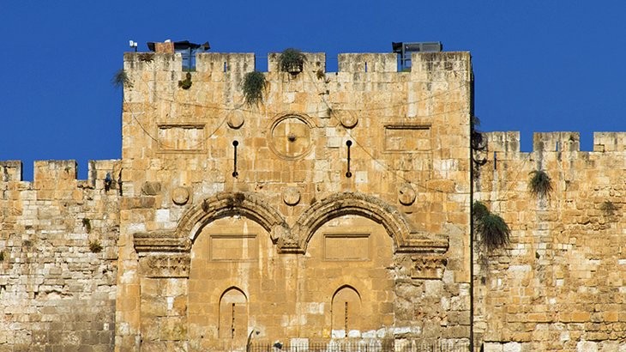
Closing of the door
Notes:
Closing of the door
No opportunity to sacrifice
Dark night – comes gradually
Rev. 14:12; Eph. 6:13; Heb. 10:36
We also want to consider the closing of the door and the night mentioned in John 9:4. Jesus said, “I must work the works of him that sent me, while it is day: the night cometh, when no man can work.” Yet Jesus did not complete his work till on the cross when he cried it is finished. We believe the church also will not complete their work till the last member joins the company of the saints on the other side.
Br. Russell suggested three possibilities for the closing of the door.
A direct scriptural statement
a reversal of public sentiment with reference to the truth
all opportunity for such service would be effectually obstructed,
It is this third possibility that the Pastor held as the most likely scenario. On C211 he states, “Nor should we expect that the coming of night and the closing of the door will be sudden, but rather that it will be a gradual obstructing and closing down of the harvest work.”
Given that the closing of the door is shown in the parable of the Wise and foolish virgins and when the Wise have already entered the marriage feast, this would leave only the foolish virgins or great company this side of the veil.
C211 Observe that, when this night cometh, when the reapers must cease their labors, it will prove that this final work of the Gospel age is accomplished; that the elect number of the Bride of Christ have all been “sealed,” and “gathered.”
And should things get so bad as to restrict service to the Lord, what would the attitude of the church be? They would respond in the same way as Peter and John did when told not to teach in the name of Jesus. Acts 4:19 “But Peter and John answered and said unto them, whether it be right in the sight of God to hearken unto you more than unto God, judge ye.”

Slide 23
Final Thoughts and Conclusions
The work of separating the wheat found in that system prior to 1881 was accomplished by the Ministry of Br. Russell. Ezekiel 9:11 “And, behold, the man clothed with linen, which had the inkhorn by his side, reported the matter, saying, I have done as thou hast commanded me.”
Notes:
The work of separating the wheat found in that system prior to 1881 was accomplished by the Ministry of Br. Russell. Ezekiel 9:11 “And, behold, the man clothed with linen, which had the inkhorn by his side, reported the matter, saying, I have done as thou hast commanded me.”

Slide 24
Final Thoughts
The work of separating the wheat found in that system prior to 1881 was accomplished by the Ministry of Br. Russell. Ezekiel 9:11 “And, behold, the man clothed with linen, which had the inkhorn by his side, reported the matter, saying, I have done as thou hast commanded me.”
The finding of replacements to fill the crowns vacated because of those who once completed the number failed to make their calling sure continues to our day. C212 he says and we believe also that “God will not permit anything to put an end to his work until it is finished.”
Notes:
(2) The finding of replacements to fill the crowns vacated because of those who once completed the number failed to make their calling sure continues to our day. C212 he says and we believe also that “God will not permit anything to put an end to his work until it is finished.”

Slide 25
Final Thoughts
The work of separating the wheat found in that system prior to 1881 was accomplished by the Ministry of Br. Russell. Ezekiel 9:11 “And, behold, the man clothed with linen, which had the inkhorn by his side, reported the matter, saying, I have done as thou hast commanded me.”
The finding of replacements to fill the crowns vacated because of those who once completed the number failed to make their calling sure continues to our day. C212 he says and we believe also that “God will not permit anything to put an end to his work until it is finished.”
The Time of Trouble already begun will gradually bring in this dark night as we can all attest to the fact that darkness is enveloping the earth and getting darker almost daily.
Notes:
(3) The Time of Trouble already begun will gradually bring in this dark night as we can all attest to the fact that darkness is enveloping the earth and getting darker almost daily

Slide 26
Final Thoughts
The work of separating the wheat found in that system prior to 1881 was accomplished by the Ministry of Br. Russell. Ezekiel 9:11 “And, behold, the man clothed with linen, which had the inkhorn by his side, reported the matter, saying, I have done as thou hast commanded me.”
The finding of replacements to fill the crowns vacated because of those who once completed the number failed to make their calling sure continues to our day. C212 he says and we believe also that “God will not permit anything to put an end to his work until it is finished.”
The Time of Trouble already begun will gradually bring in this dark night as we can all attest to the fact that darkness is enveloping the earth and getting darker almost daily
The dark night or darkest time of the trouble and the closing of the door means the church is complete.
Notes:
(4) The dark night or darkest time of the trouble and the closing of the door means the church is complete.

Slide 27
Final Thoughts
The work of separating the wheat found in that system prior to 1881 was accomplished by the Ministry of Br. Russell. Ezekiel 9:11 “And, behold, the man clothed with linen, which had the inkhorn by his side, reported the matter, saying, I have done as thou hast commanded me.”
The finding of replacements to fill the crowns vacated because of those who once completed the number failed to make their calling sure continues to our day. C212 he says and we believe also that “God will not permit anything to put an end to his work until it is finished.”
The Time of Trouble already begun will gradually bring in this dark night as we can all attest to the fact that darkness is enveloping the earth and getting darker almost daily
The dark night or darkest time of the trouble and the closing of the door means the church is complete.
R5761 But meantime, before this dark night fully sets in, we are to go right on with the work which the Lord has put into our hands. The Truth is designed, not only to perfect the "Bride" of Christ, the Chief of the First-borns, but to develop the Great Company class, and also to be a witness to the whole world.
Notes:
(5) R5761 This Time of Trouble will overtake the reaping work and bring it to a close. But the Time of Trouble will go on, the plowman will keep on plowing, after all our efforts have ended in respect to the reaping. But meantime, before this dark night fully sets in, we are to go right on with the work which the Lord has put into our hands. The Truth is designed, not only
to perfect the "Bride" of Christ, the Chief of the First-borns, but
to develop the Great Company class, and
to be a witness to the whole world.
Any carelessness on our part, or any cessation of activity in the service of the Truth while opportunity yet remains, would in our estimation be a great mistake. If we are loyal, the Lord will give us far greater opportunities in the future – the blessing of all the nations, all the kindred, all the families of the earth. – Galatians 3:8,16,29.

Slide 28
Rev. 2:10 Be Thou Faithful Unto Death and I will give thee a Crown of Life
AMEN
Notes:
Rev. 2:10 Be Thou Faithful Unto Death and I will give thee a Crown of Life
AMEN

Slide 29
Hymn 230 - Behold The Bridegroom
1 Our lamps are trimmed and burning,
Our robes are white and clean,
We’ve tarried for the Bridegroom,
And now we’ll enter in.
We know we’ve nothing worthy
That we can call our own-
The light, the oil, the robes we wear,
Are all from him alone.
Chorus
Behold, behold the Bridegroom!
And all may enter in,
Whose lamps are trimmed and burning,
Whose robes are white and clean.

Slide 30
Hymn 230 - Behold The Bridegroom
2 Go forth-we soon shall see him,
The way is shining now,
All lighted with a glory
None other could bestow.
His gracious invitation
Beyond deserving kind,
We gladly own and take our lamps,
And joy eternal find.
Chorus
Behold, behold the Bridegroom!
And all may enter in,
Whose lamps are trimmed and burning,
Whose robes are white and clean.

Slide 31
Hymn 230 - Behold The Bridegroom
3 We see the marriage splendor
Within the open door;
We know that those who enter
Are blest forevermore;
We see our King, more lovely
Than all the sons of men;
We haste because that door, once shut,
Will never ope again.
Chorus
Behold, behold the Bridegroom!
And all may enter in,
Whose lamps are trimmed and burning,
Whose robes are white and clean.

